Slide 1


Slide 2

AZTECS
presents
ANAS AHMED
AMAN AKHTER
MUSKAN TIRKEY
UVAIS SIDDIQUI

Slide 3

HEALTH IS WEALTH

Slide 4
WHAT IS HEALTH
Health is a destination that we reach to help us become productive in life
Health, according to the world health Organization is a state of complete physical, mental and social well-being and not merely the absence of disease and infirmity

Slide 5
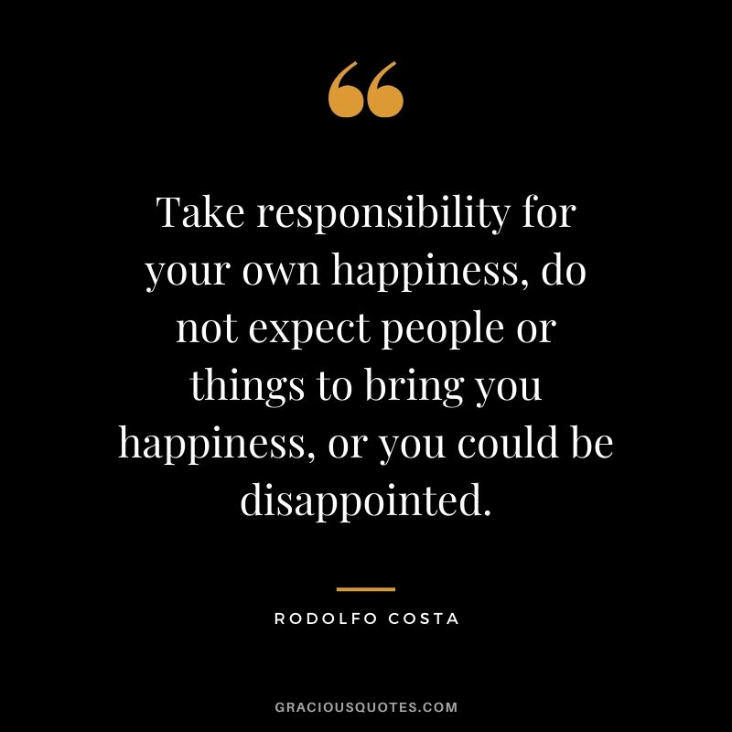
Good health is not something that can be bought nor a condition that can be regained easily after getting sick. It is your responsibility to make your body healthy.

Slide 6

WHAT IS WEALTH
The word wealth is derived from the old english weal, meaning well being ,according to kevin james wood.
A standard definition of wealth is it’s the abundance of valuable resources or material possession or spritual blessings. A person, a community, region or country that has an abundance of valuable possessions or is generally regarded as having wealth.

Slide 7
The famous proverb health is wealth means health is the most significant wealth. Not money
The real wealth is healthy habits such as a balanced diet . Exercise. Regular sleep that one inculcates over a period of
The world health organization commemorates the annual celebration of world health day on April 7 . To create awareness among people about about health and cleanliness

Slide 8
‘Health is wealth’ is a very famous saying which means that where there is health there is wealth. A healthy person has the power to achieve everything in life.

Slide 9
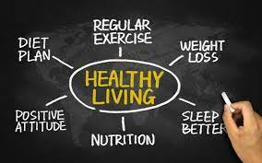

Slide 10
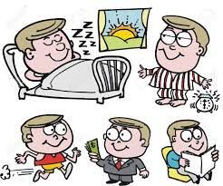
BE HEALTHY AND WEALTHY

Slide 11
TEAM
AZTECS

Slide 12
THANK YOU

